Slide 1


Machine Learning for Hydrologic Prediction in Water Resources Management Models
WORLD ENVIRONMENTAL & WATER RESOURCES CONGRESS
SACRAMENTO, CALIFORNIA | MAY 21–25, 2017
ELLIE WHITE, Graduate Student, elawhite@ucdavis.edu
JON HERMAN, Assistant Professor, jdherman@ucdavis.edu
MARIELLE PINHEIRO, Graduate Student mcpinheiro@ucdavis.edu
JAY LUND, Director of the Center for Watershed Science jrlund@ucdavis.edu
SUPPORTED BY: NSF DGE # 1069333, the Climate Change, Water, and Society IGERT, to UC Davis
Any opinion, findings, and conclusions or recommendations expressed in this material are those of the authors(s) and do not necessarily reflect the views of the National Science Foundation.

Slide 2

Introduction
“We are drowning in data and starving for knowledge” –Rutherford D. Roger
Hydrologic models:
mechanistic (process-based)
empirical (statistical)
Aim: predict the hydrologic responses of California basins using statistical models
Make accurate predictions using random forests
by J. J. SEMPÉ
Notes:
Each approach inevitably sacrifices some generality, realism, cost and precision for better understanding, predicting and managing natural resources. Hydrologists often develop mechanistic models to capture complex runoff processes, with considerable limitations from input field data and calibration to basin-specific parameters. As mechanistic models increase in complexity, it is unclear if hydrological predictions improve commensurately. Without a unifying approach, and considering the increasing availability of environmental data, there is merit in the more economical predictive power of statistical models.
In machine learning, computers apply statistical learning techniques to automatically identify patterns in data. These techniques can be used to make accurate predictions.
We can then use these statistical models in managing complex natural resource systems.

Slide 3

Research Questions
Q1) Can machine-learning models give better and more cost effective streamflow predictions for drought, flood and water management applications compared to mechanistic models?
Q2) How will including other variables that contribute to flow (e.g., basin topography, location, and soil properties) improve the model’s predictive capabilities?
by J. J. SEMPÉ

Slide 4
Method
Input Data
- - - - - - - - - - - - - - - - -
Response| Predictor
Missing Data
Test
Train
Future Predictions
ML Model
can be applied to
Ungauged Basins
ML Prediction
Measures of Fit
Notes:
We just have to be careful: using statistical models for extrapolation involves some risk and they shouldn’t be strained too much beyond their limits.

Slide 5
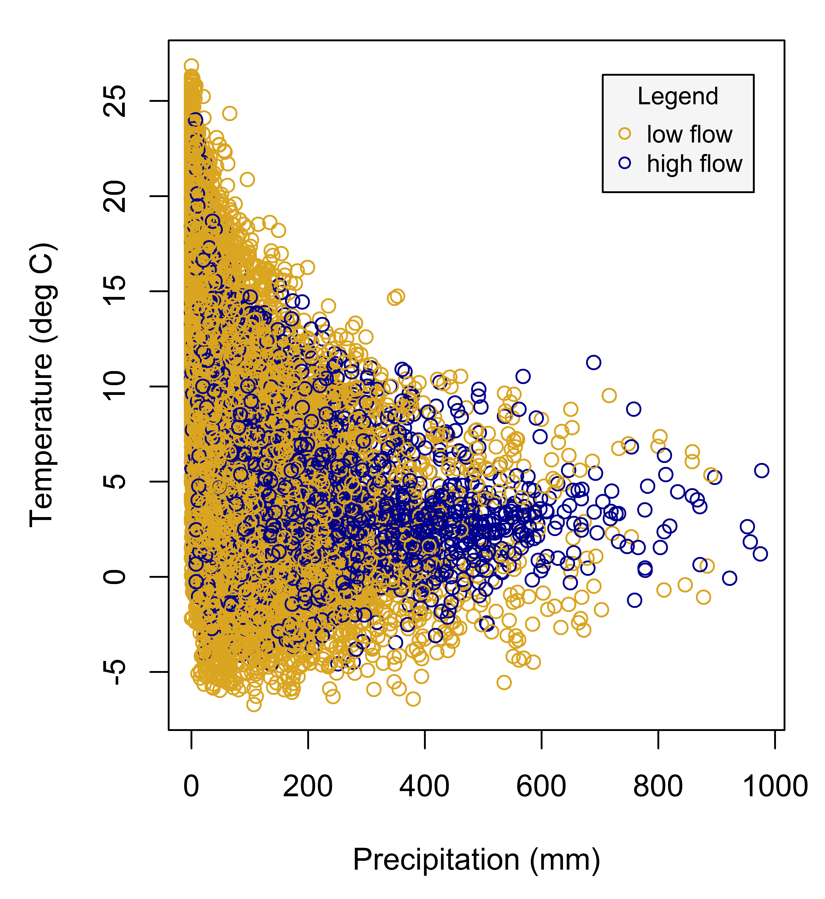
ML Models
?
In machine learning, computers apply statistical learning techniques to automatically identify patterns in data.
Machine learning methods use statistical learning to identify boundaries and patterns in the data.
One example of a machine learning method is a decision tree. Decision trees look at one variable at a time.
?

Slide 6
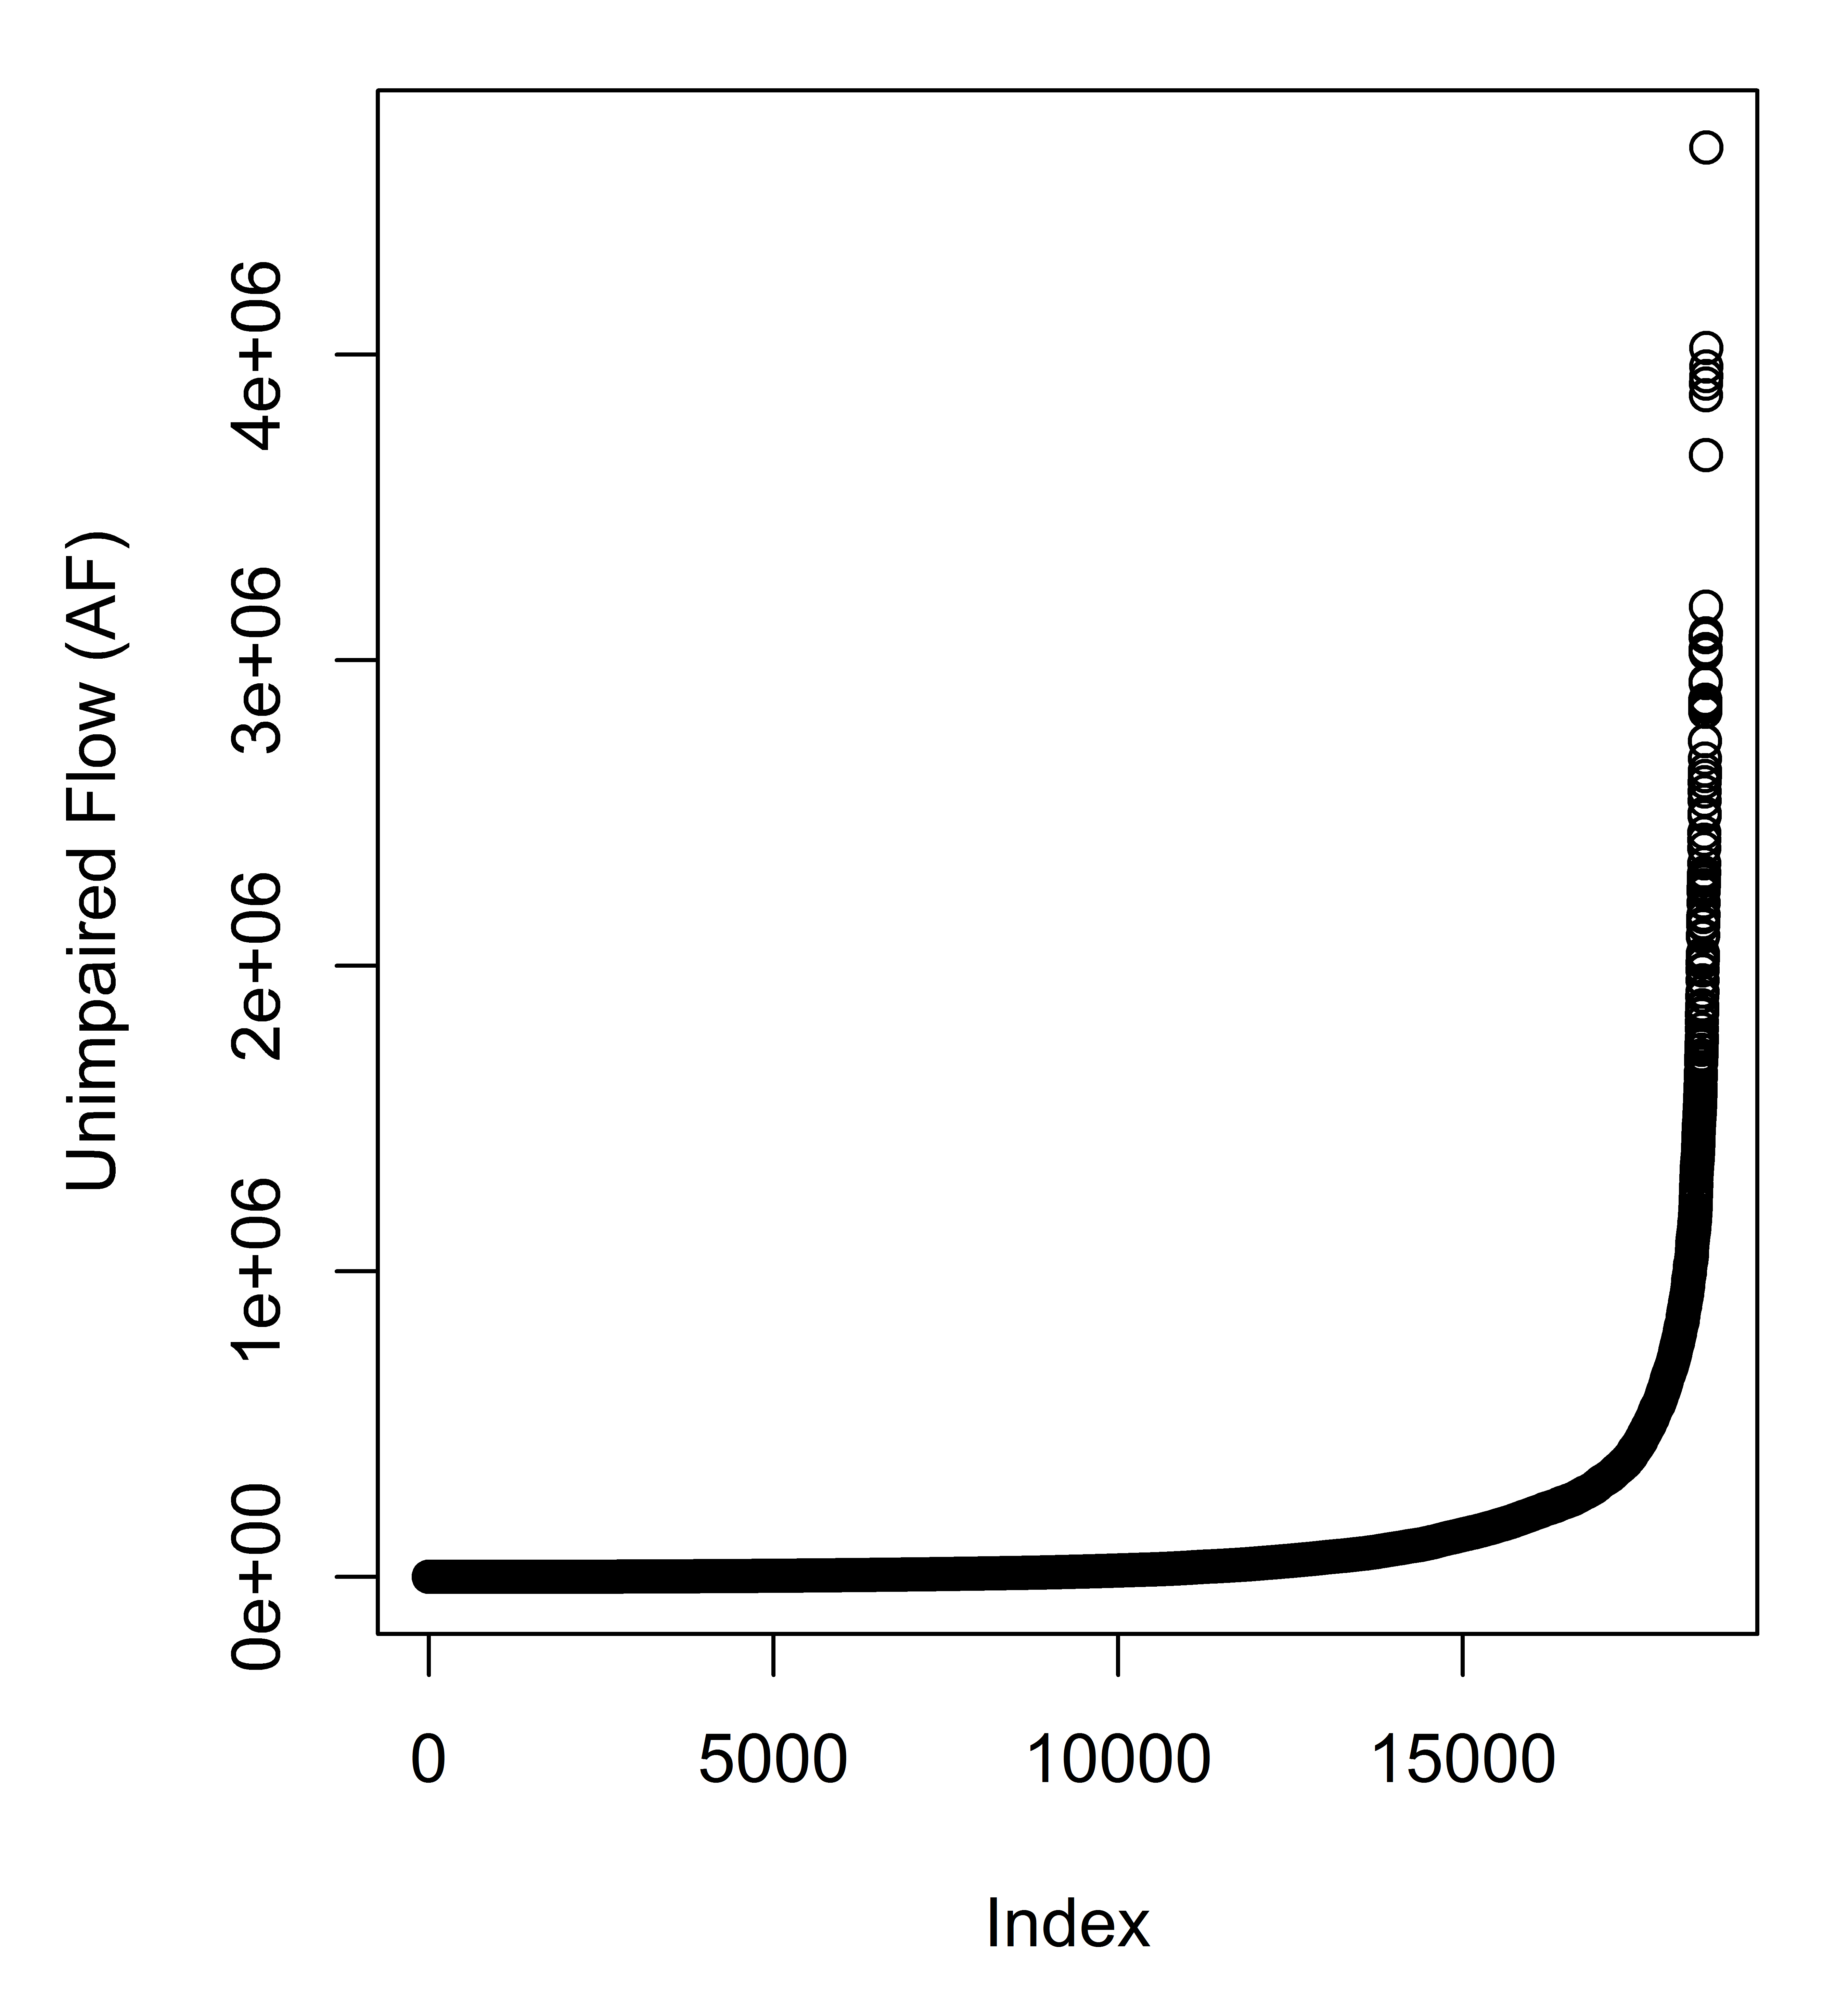
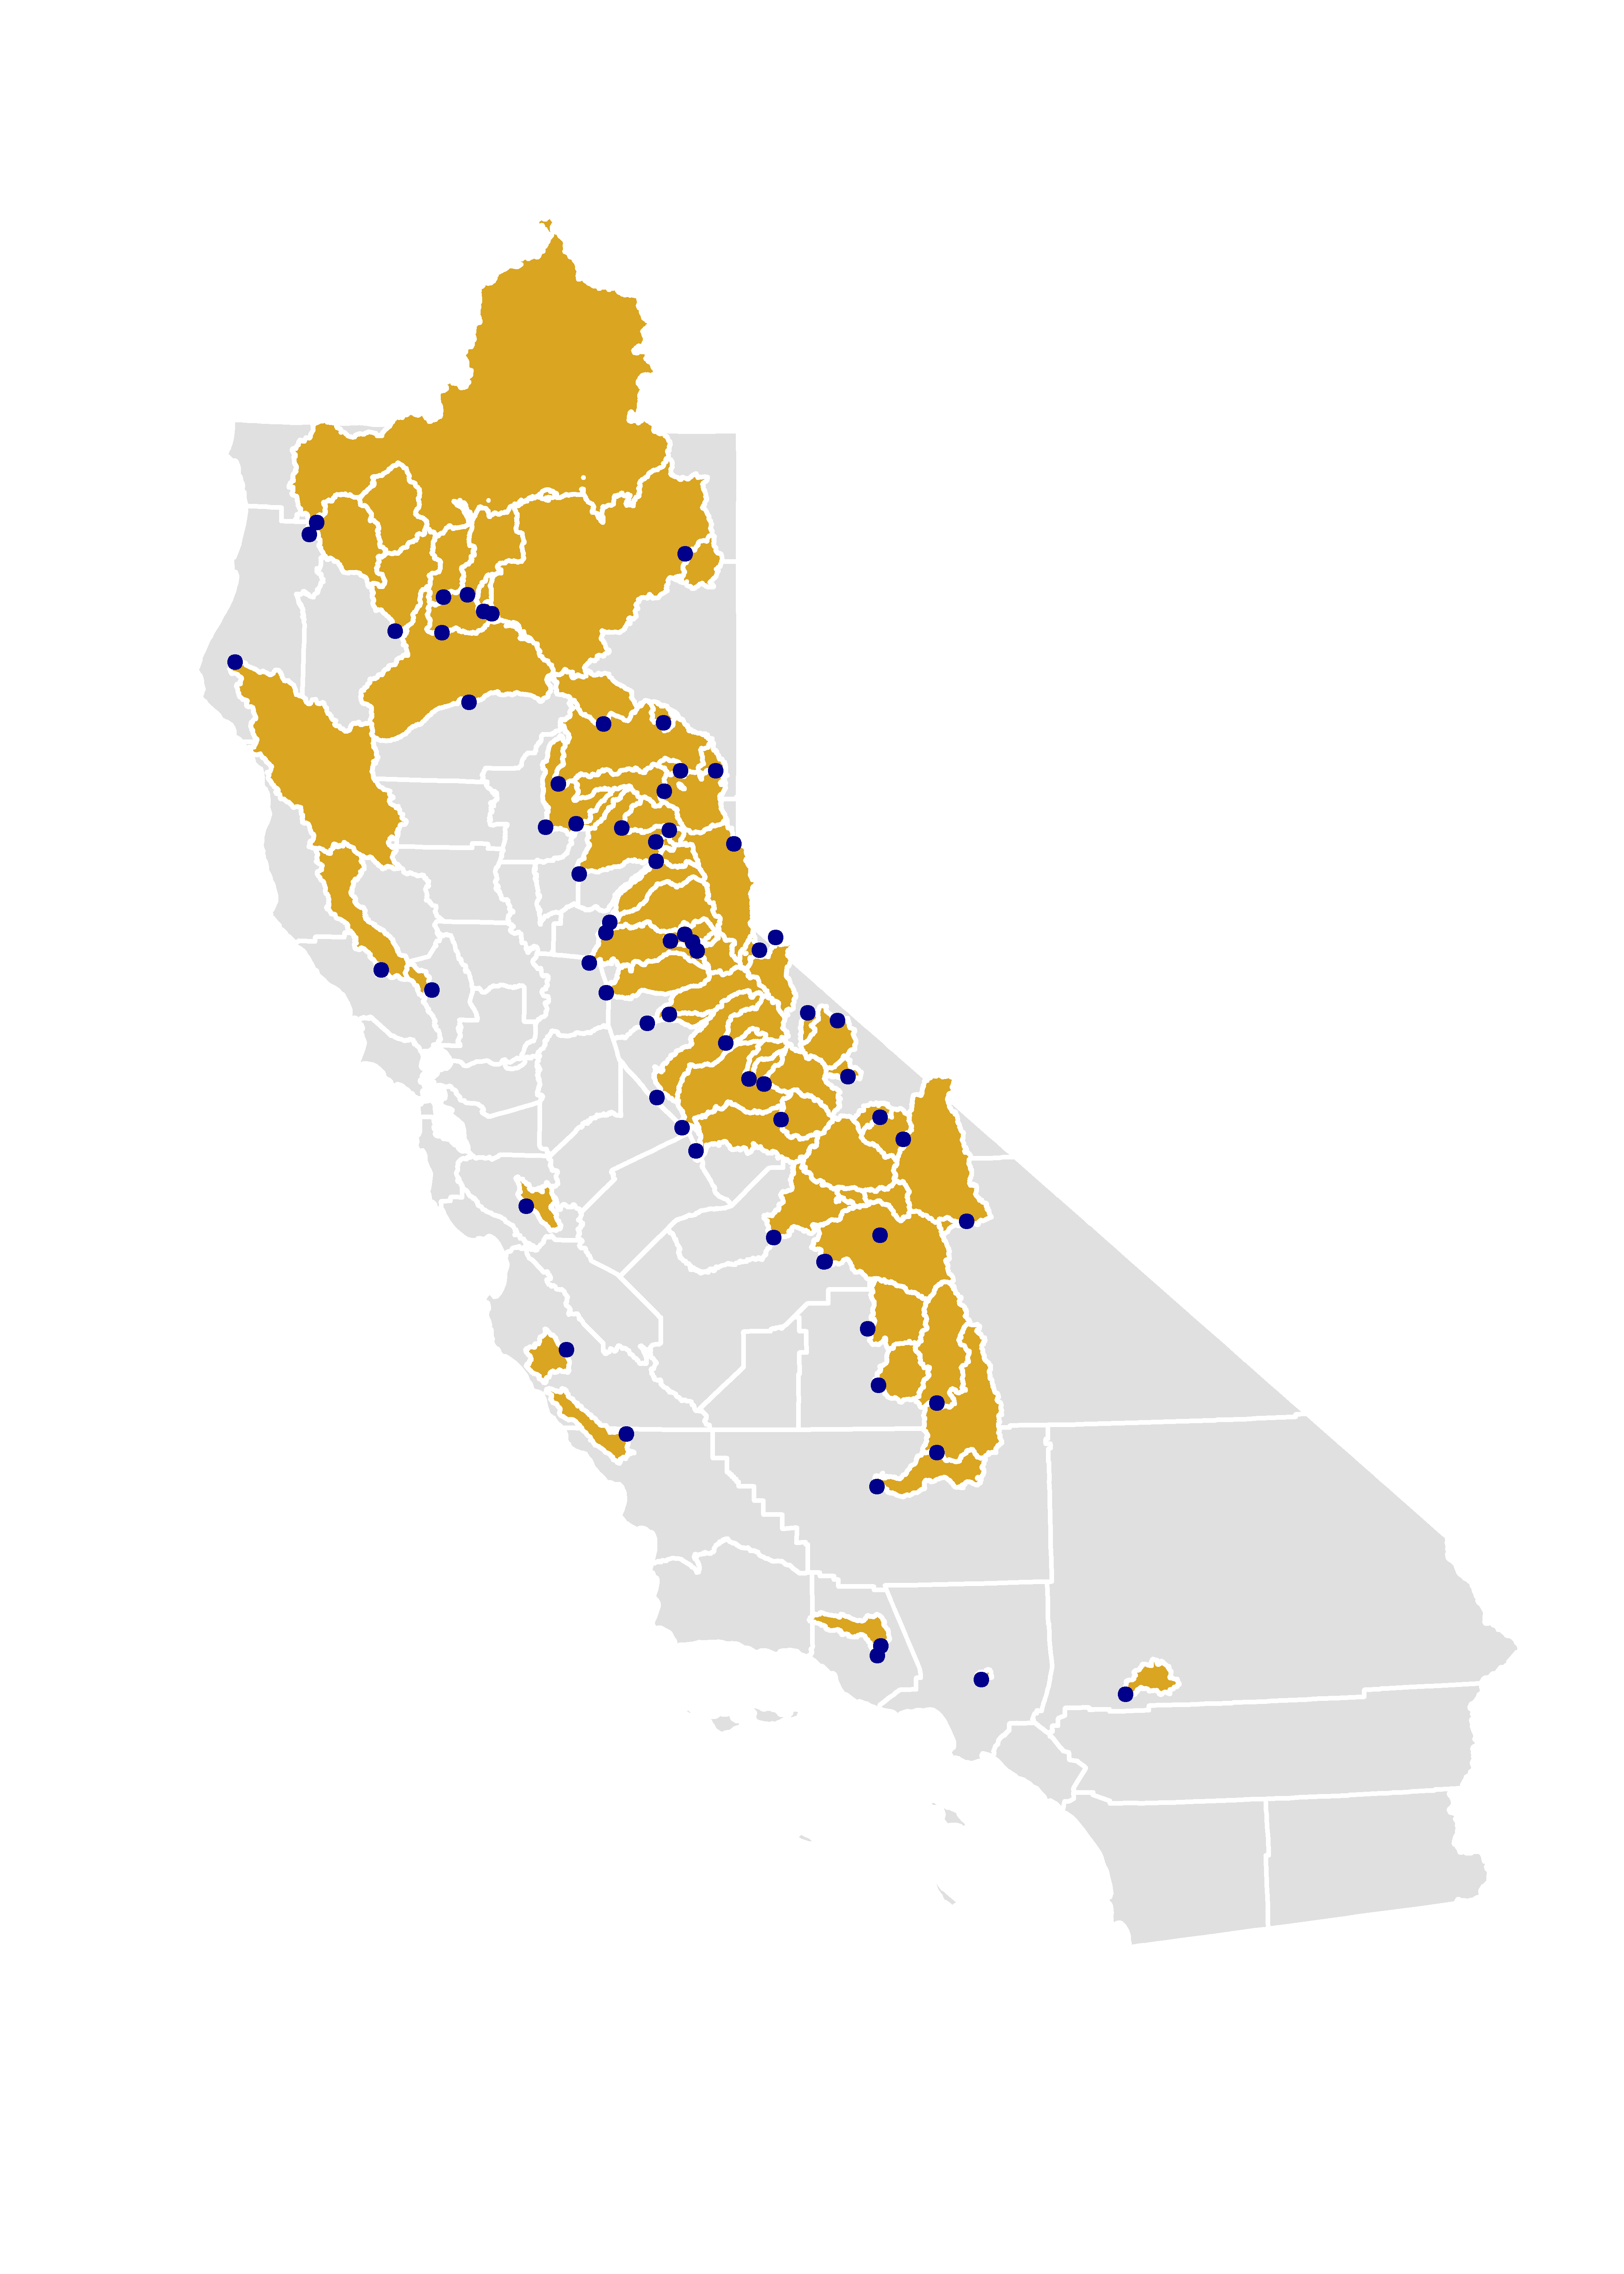
Input Data: Response Variable
Monthly unimpaired flow from California Data Exchange Center (CDEC)
69 CA basins
1982-2014
18,500 instances

Slide 7
Input Data: Predictor Variables
Climate --PRISM
PPT (mm)
PPT LAG1
PPT LAG2
PPT LAG3
SNOW
TMP (˚C)
TMP LAG1
TMP LAG2
TMP LAG3
Hypsometric --SRTM90
BASIN RELIEF RATIO
MEAN ELEV (m)
Time
MONTH
Basin Boundaries--NHD2PLUS
DRAINAGE AREA (sqkm)
SHAPE
COMPACTNESS
Soil --POLARIS ← SURRGO
CLAY
SILT
SAND
KSAT
Geology--NRCS
DOMINANT GEOLOGY

Slide 8
Input Data: Predictor Variables

Slide 9
Model: Classification & Regression Tree (CART)
unimpaired flow
prediction
Notes:
CART: Uses all the predictor variables to make splits, Makes the best split based on the homogeneity of the child nodes, Calculated by the Node Purity.
CART gives us a nice tree to look at but it doesn’t do well on predicting a continuous variable. So … we move on to RF model.
RF, injects randomness in the cart and , Grows a lot of trees, then Averages the predictions.

Slide 10
Model: Random Forest
unimpaired flow
prediction
Notes:
CART gives us a nice tree to look at but it doesn’t do well on predicting a continuous variable. So … we move on to RF model.
RF, injects randomness in the cart and , Grows a lot of trees, then Averages the predictions.

Slide 11
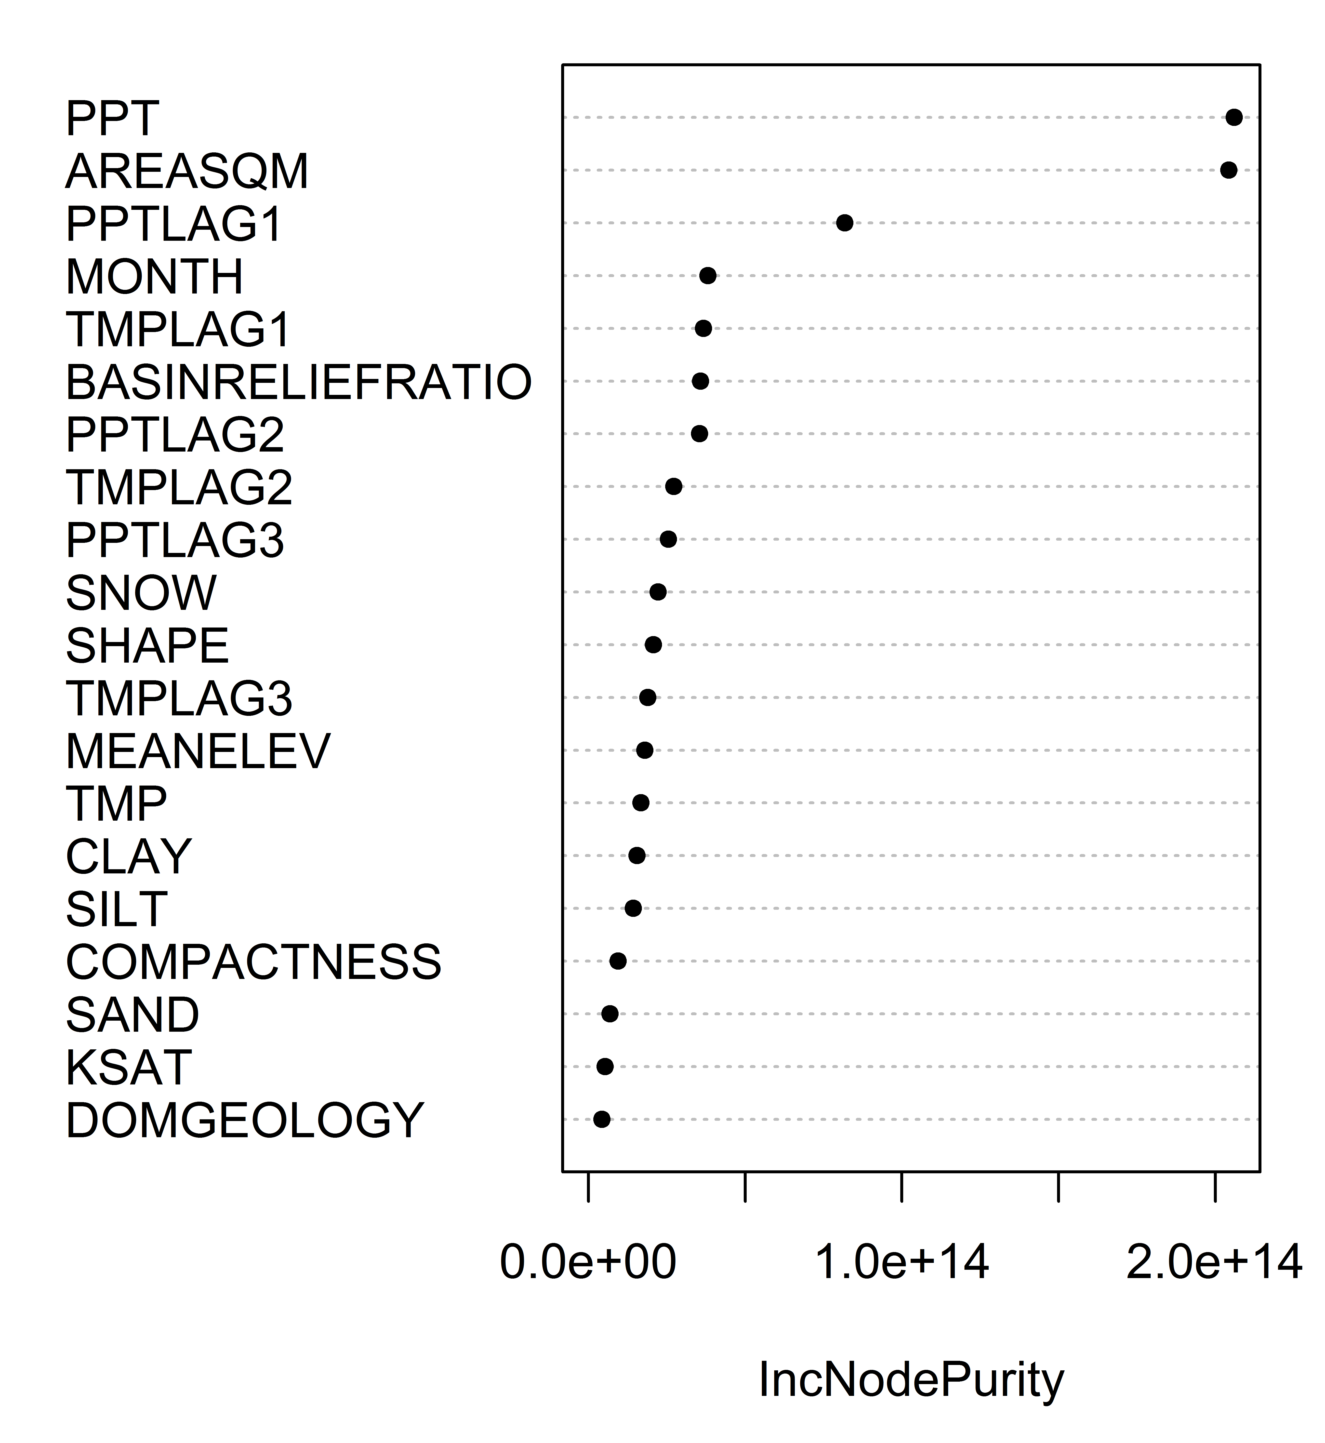
Results: Random Forest
Q2) How will including other variables that contribute to flow (e.g., basin topography, location, and soil properties) improve the model’s predictive capabilities?
Goodness of Split

Slide 12
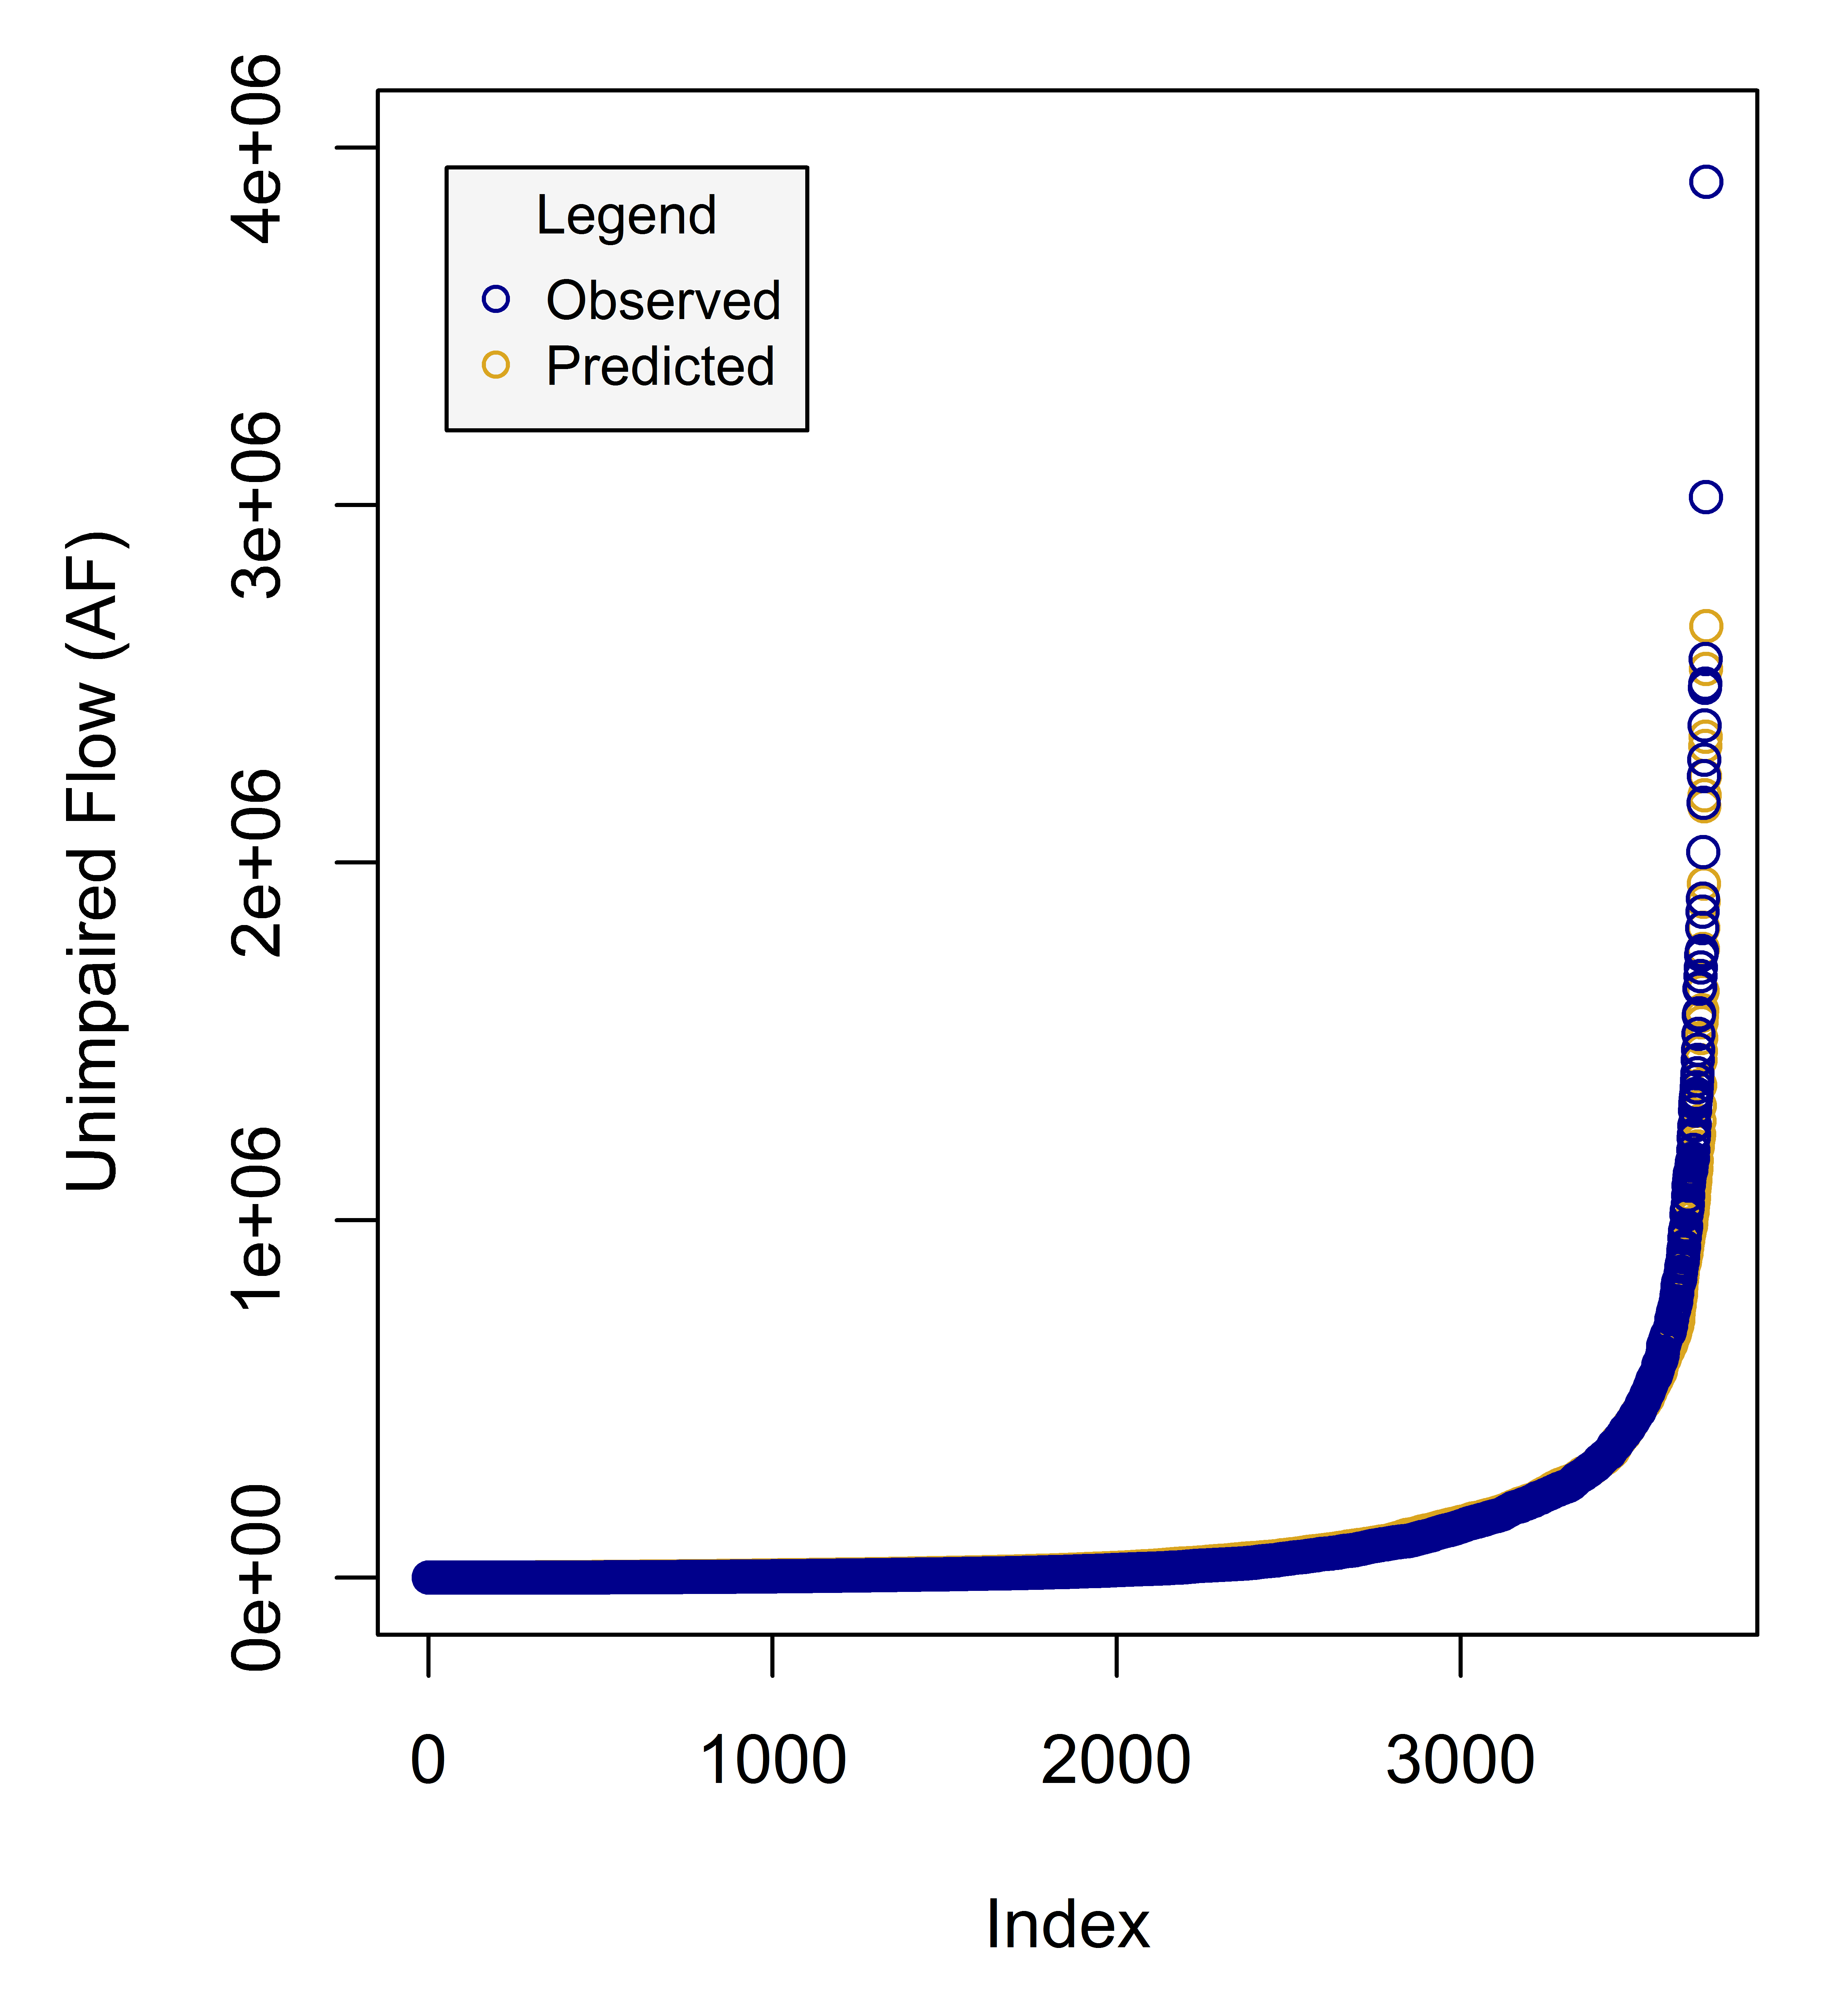
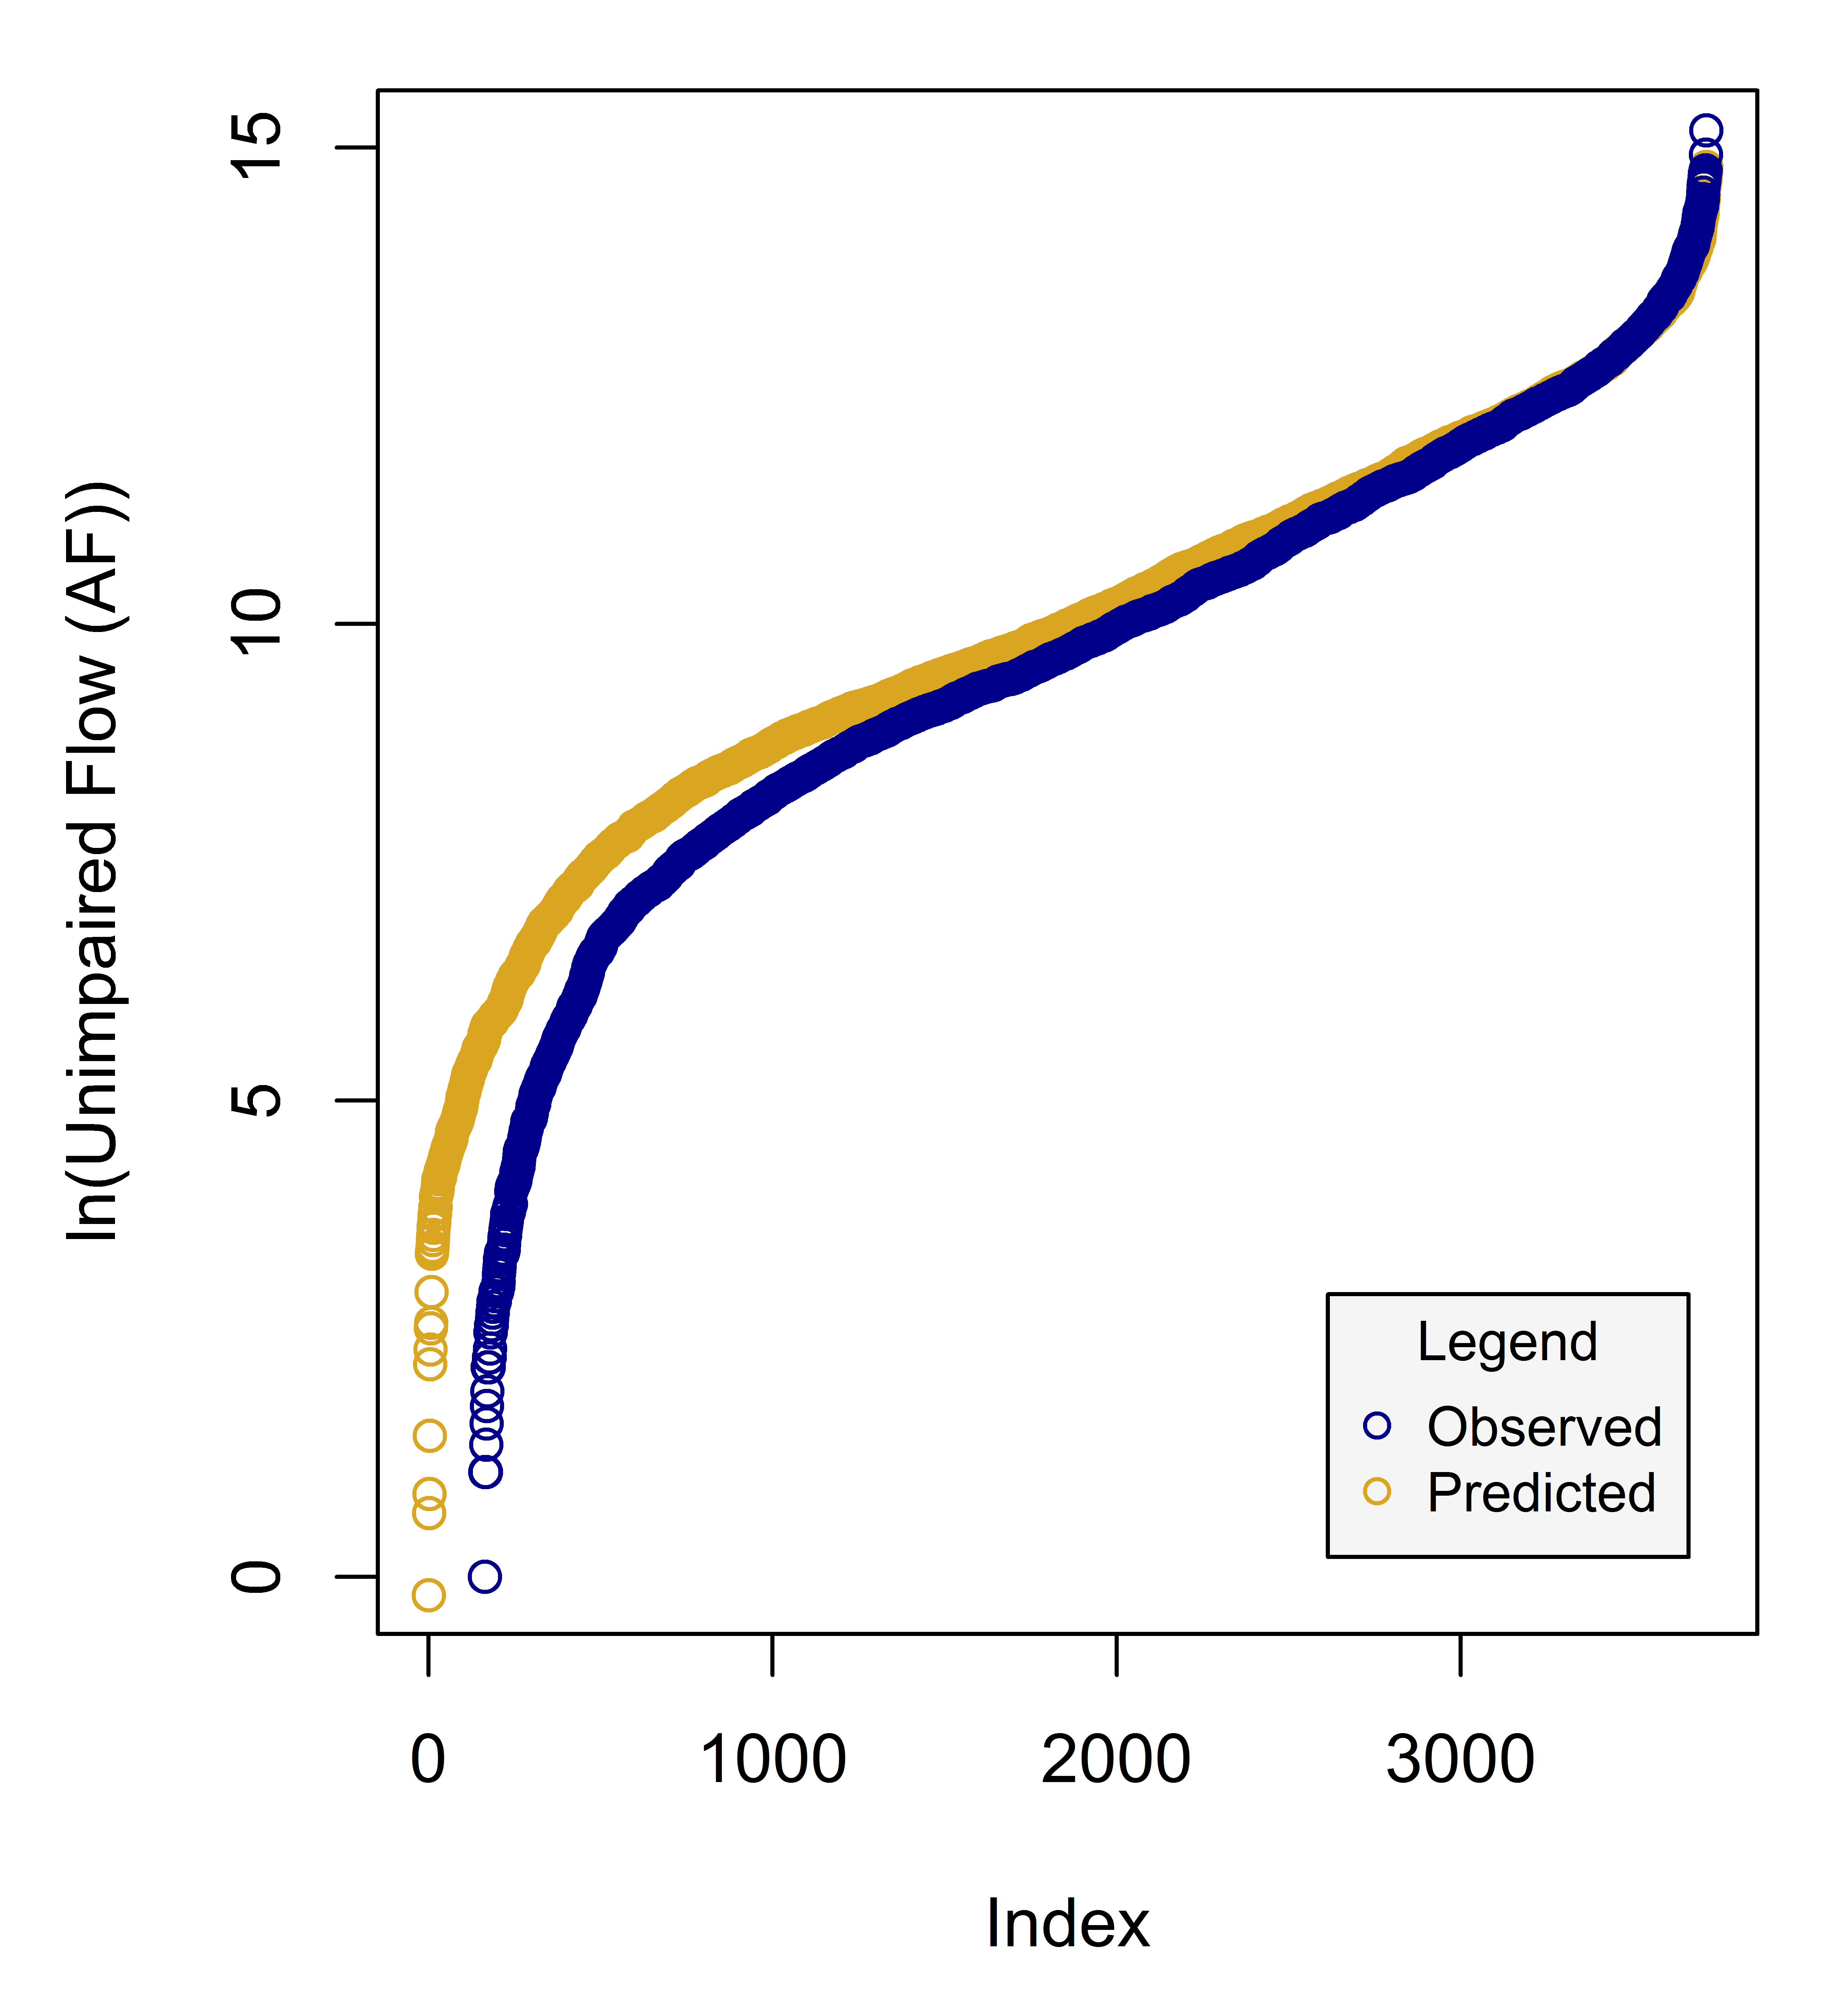
Results: Random Forest

Slide 13
Results: Model Fit
R2 (Coefficient of Determination): 0.883
RMSE (Root Mean Square Error): 85134 AF
RSR (RMSE standard deviation ratio): 0.346
NSE (Nash-Sutcliffe Efficiency): 0.880
PBIAS (Percent Bias): 0.061 %
Table 4. general performance ratings for recommended statistics for a monthly time-step (Moriasi, Daniel N., 2007)
Performance Metric | RSR | NSE | PBIAS
Very Good | 0.00 < RSR < 0.50 | 0.75 < NSE < 1.00 | PBIAS < ±10
Good | 0.50 < RSR < 0.60 | 0.65 < NSE < 0.75 | ±10 < PBIAS < ±15
Satisfactory | 0.60 < RSR < 0.70 | 0.50 < NSE < 0.65 | ±15 < PBIAS < ±25
Unsatisfactory | RSR > 0.70 | NSE < 0.50 | PBIAS > ±25

Slide 14
Results: Model Fit
Categories to diagnose a:
Overfitting problem?
Low flow problem?
Large basin problem?
n = n = n = n = n = n =
14822 3714 859 2855 1016 2698
train
set
test
set
high
flows
low
flows
large
basins
small
basins

Slide 15
Results: Benchmarking
Q1) Can machine-learning models give better and more cost effective streamflow predictions for drought, flood and water management applications compared to mechanistic models?
Notes:
The RF does better in all watersheds compared to the physically based model, the RF does considerably better than the LMR in all but one., which is expected since we know that runoff processes are not linear.
The one where LMR does better than the RF and the physically based model is the Mokolumne watershed… needs more investigating if we want to improve the model. Which brings me to diagnosing problems in models

Slide 16
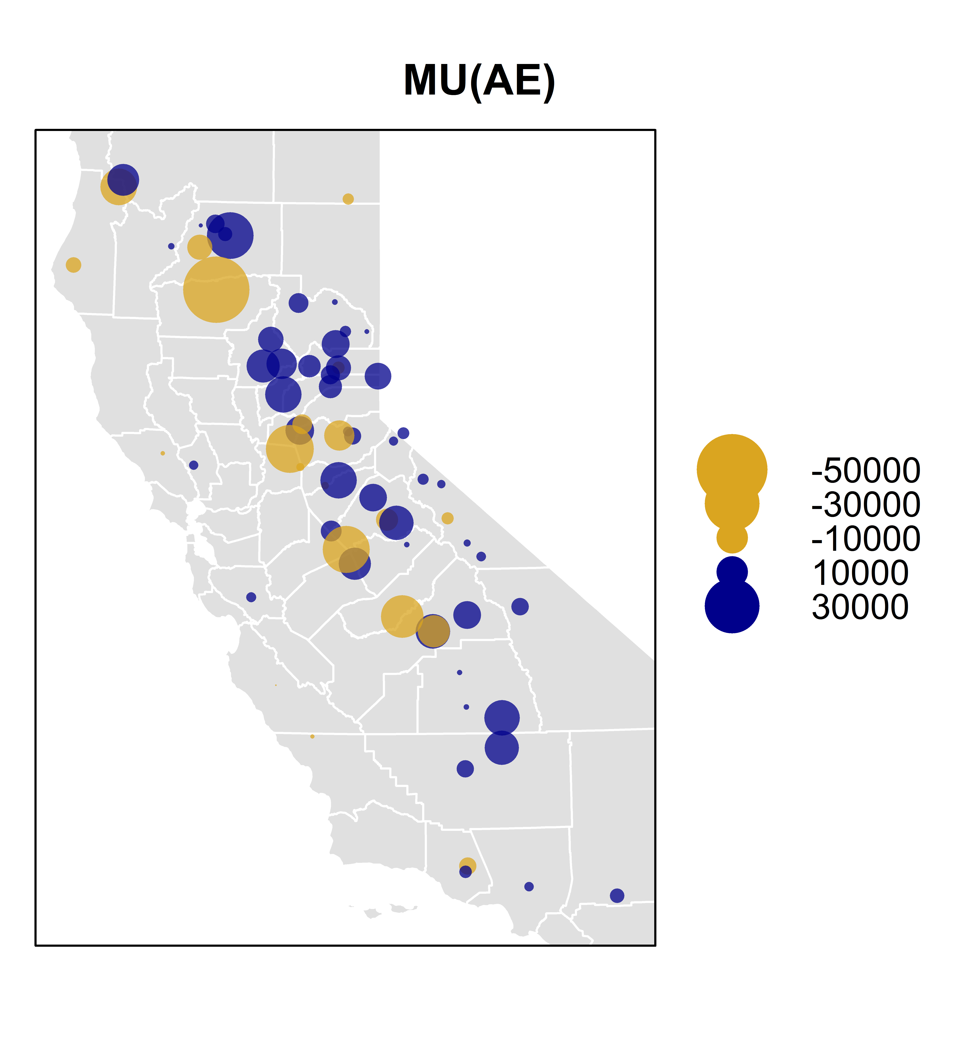
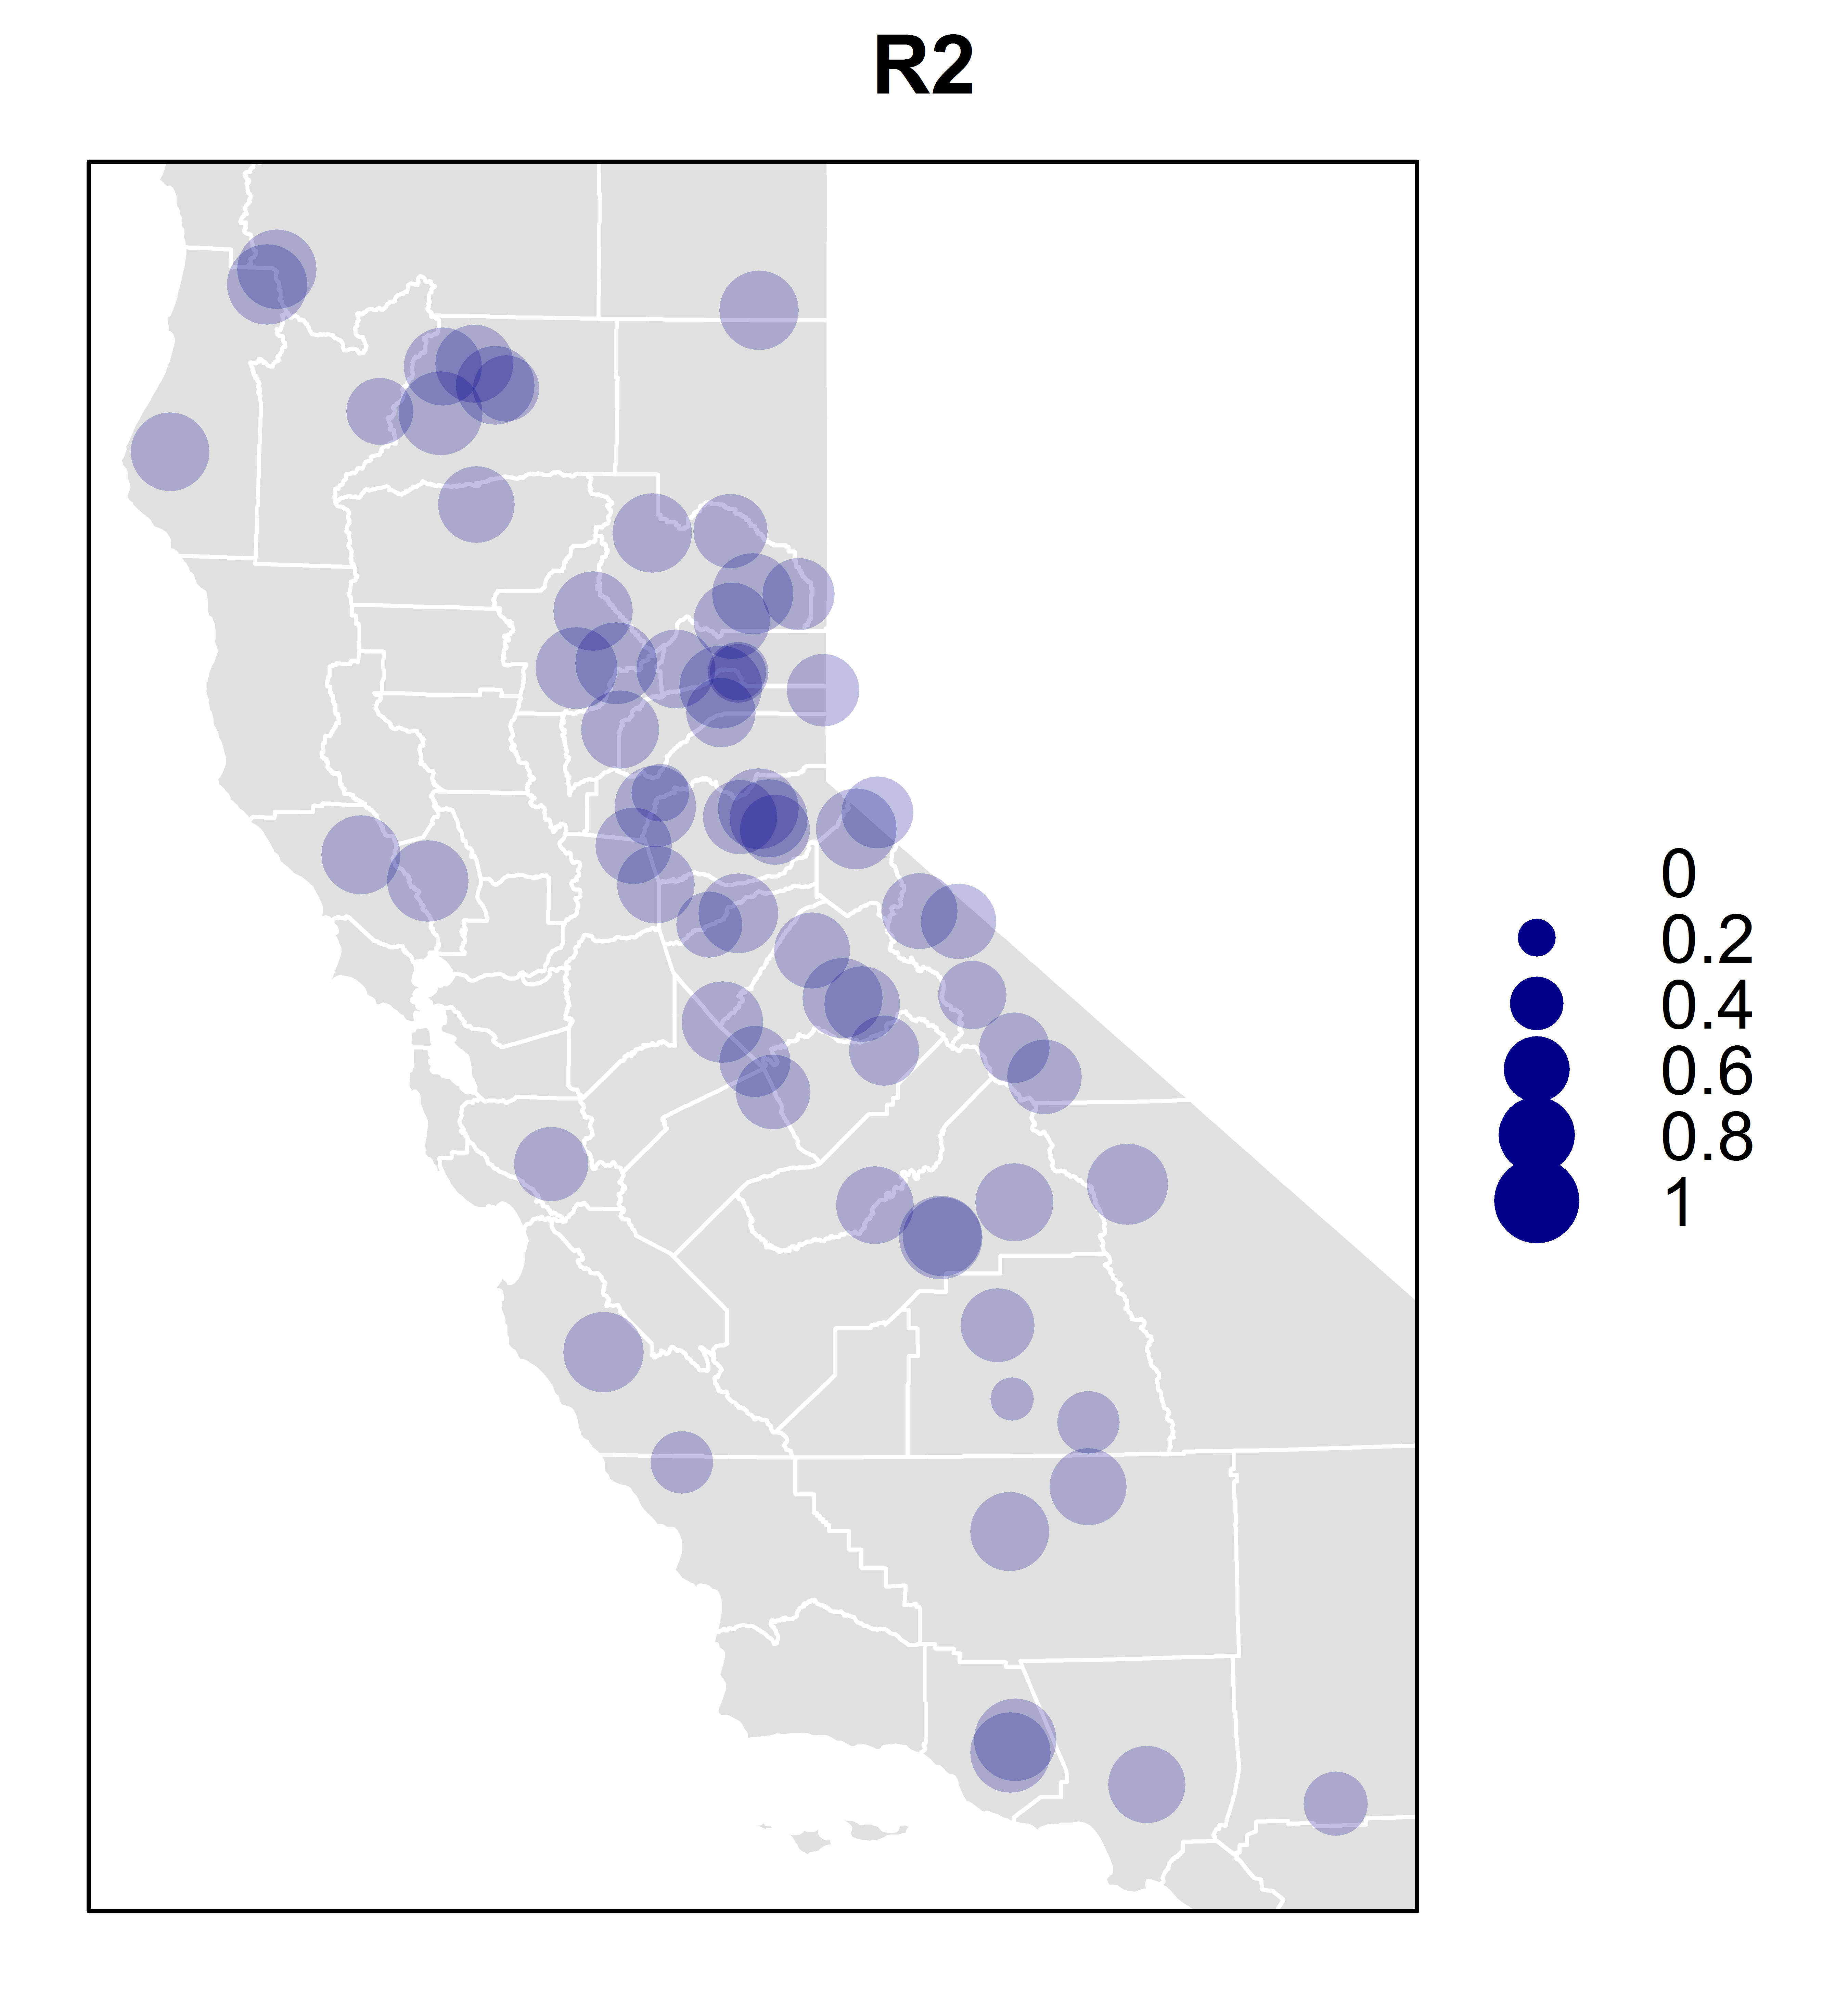
Model Improvement
Mean (AE)
R²
Notes:
We can look at the spatial distribution of the absolute error, and if we see a clear trend in the error, then it can provide clues as to what other predictor variables to include in the data to get rid of that trend. here we do see a trend, in this ridge of under-predicting and everywhere else over-predicting. We can also look at the R2 values by basin and identify problem areas. So maybe if we improve the model at this basin here we will end up improving the model overall.

Slide 17

Conclusions
Statistical learning models enable us to make models that are
Quick to build/run
Easy to use
Just based on the data
Because of the good fit this model can be applied to California basins
Next steps: model improvement
Spatial autocorrelation of the residuals
Spatially distributed R² values
by J. J. SEMPÉ

Slide 18
Citations
R Core Team (2017). R: A language and environment for statistical computing. R Foundation for Statistical Computing, Vienna, Austria. URL https://www.R-project.org/ . R version 3.4.0 (2017-04-21) -- "You Stupid Darkness"
Taiyun Wei and Viliam Simko (2016). corrplot: Visualization of a Correlation Matrix. R package version 0.77. https://CRAN.R-project.org/package=corrplot
Pebesma, E.J., R.S. Bivand, 2005. Classes and methods for spatial data in R. R News 5 (2), https://cran.r-project.org/doc/Rnews/ .
Roger S. Bivand, Edzer Pebesma, Virgilio Gomez-Rubio, 2013. Applied spatial data analysis with R, Second edition. Springer, NY. http://www.asdar-book.org/
Terry Therneau, Beth Atkinson and Brian Ripley (2017). rpart: Recursive Partitioning and Regression Trees. R package version 4.1-11. https://CRAN.R-project.org/package=rpart
A. Liaw and M. Wiener (2002). Classification and Regression by randomForest. R News 2(3), 18--22.
Robert J. Hijmans (2016). raster: Geographic Data Analysis and Modeling. R package version 2.5-8. https://CRAN.R-project.org/package=raster
Roger Bivand and Colin Rundel (2017). rgeos: Interface to Geometry Engine - Open Source (GEOS). R package version 0.3-23. https://CRAN.R-project.org/package=rgeos
Roger Bivand, Tim Keitt and Barry Rowlingson (2017). rgdal: Bindings for the Geospatial Data Abstraction Library. R package version 1.2-7. https://CRAN.R-project.org/package=rgdal
Edmund M. Hart and Kendon Bell (2015) prism: Download data from the Oregon prism project. R package version 0.0.6 http://github.com/ropensci/prism DOI: 10.5281/zenodo.33663
USDA-NRCS Soil Survey Staff (2016). sharpshootR: A Soil Survey Toolkit. R package version 1.0. https://CRAN.R-project.org/package=sharpshootR
Hadley Wickham (2007). Reshaping Data with the reshape Package. Journal of Statistical Software, 21(12), 1-20. URL http://www.jstatsoft.org/v21/i12/ .
Nathaniel W. Chaney, Eric F. Wood, Alexander B. McBratney, Jonathan W. Hempel, Travis W. Nauman, Colby W. Brungard, Nathan P. Odgers, POLARIS: A 30-meter probabilistic soil series map of the contiguous United States, Geoderma, Volume 274, 15 July 2016, Pages 54-67, ISSN 0016-7061, https://doi.org/10.1016/j.geoderma.2016.03.025.

Slide 19

Questions?
by A. GETZ

Slide 20

Relevant xkcd
Notes:
Doing that will more than likely not help the performance of the model. What makes the data speak is the process. adding noise features that are not truly associated with the response will lead to a deterioration in the fitted model, and consequently an increased test set error. This is because noise features increase the dimensionality of the problem, exacerbating the risk of having trees in the forest that do not make splits on the variables we know better describe flow.

Slide 21
Input Data: Unimpaired Flow
Evap
Qin
ΔS
Qdiv
Qimp
Qout
UF = Qout – Qimp + Qdiv + ΔS + Evap

Slide 22
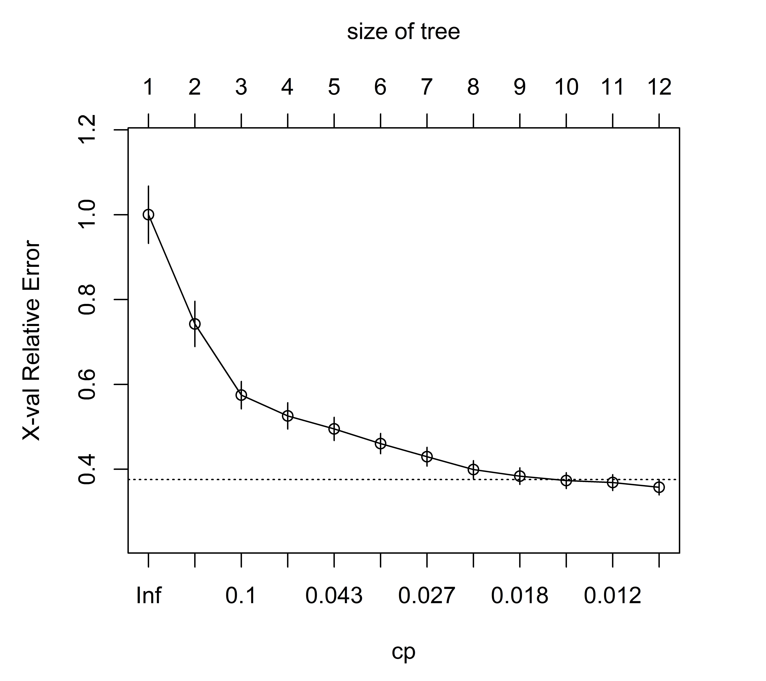
CART: Tree Size

Slide 23
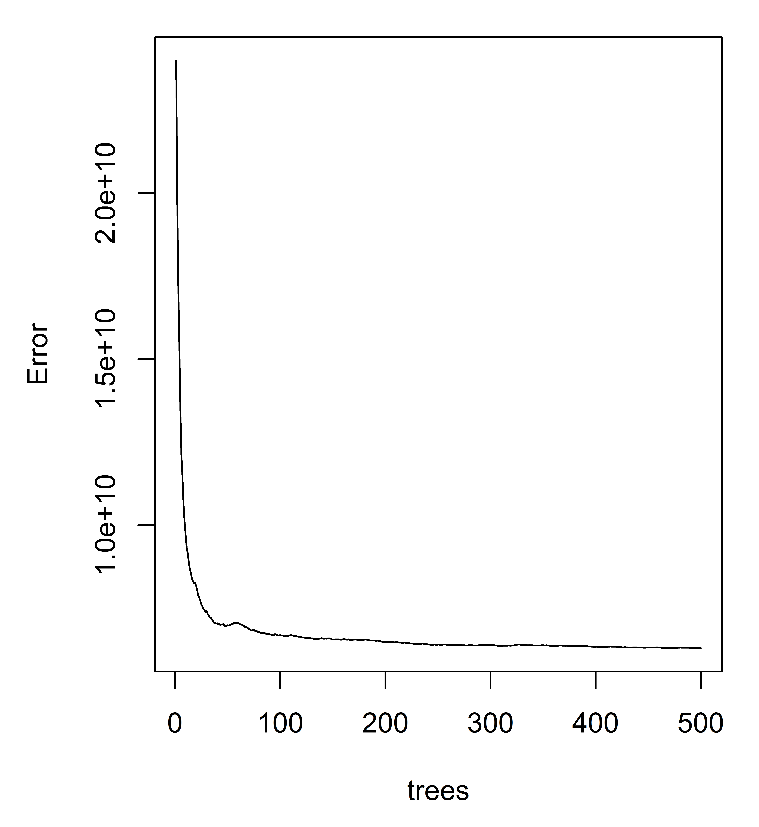
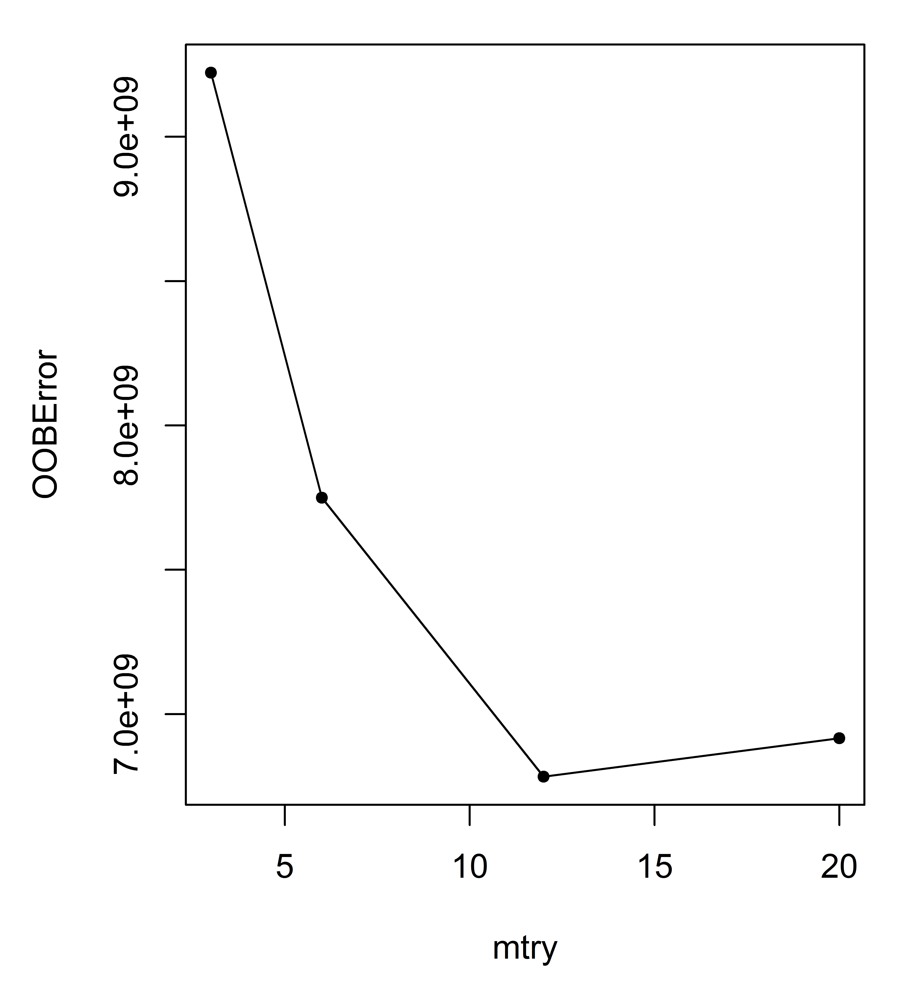
Results: Random Forest

Slide 24
Next Steps
Cross validation iterations, to find the sensitivity of the model to data
Hold out whole basins, and evaluate the model
Expand to global watersheds
PCA
Benchmark with the hydromad model: Unit Hydrogrph Model

Slide 25
Results: Model Fit
R2
RMSE
NSE
RSR
PBIAS

